Slide 1
Triathlon Presentation
Gianna and Chris

Slide 2
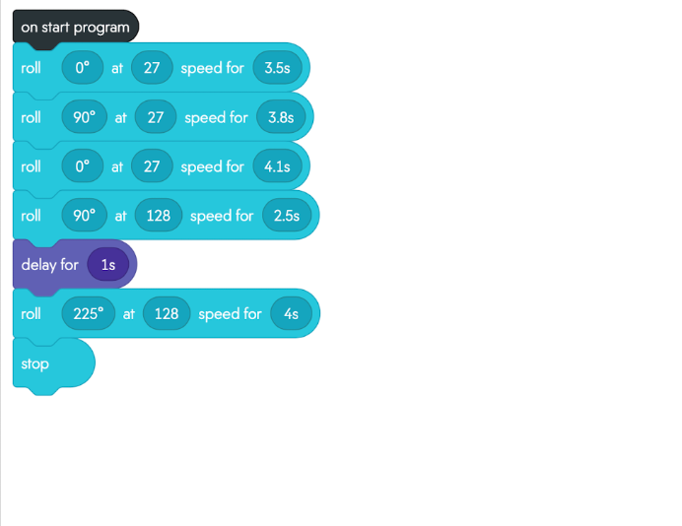
Block Code for Sprint 3

Slide 3
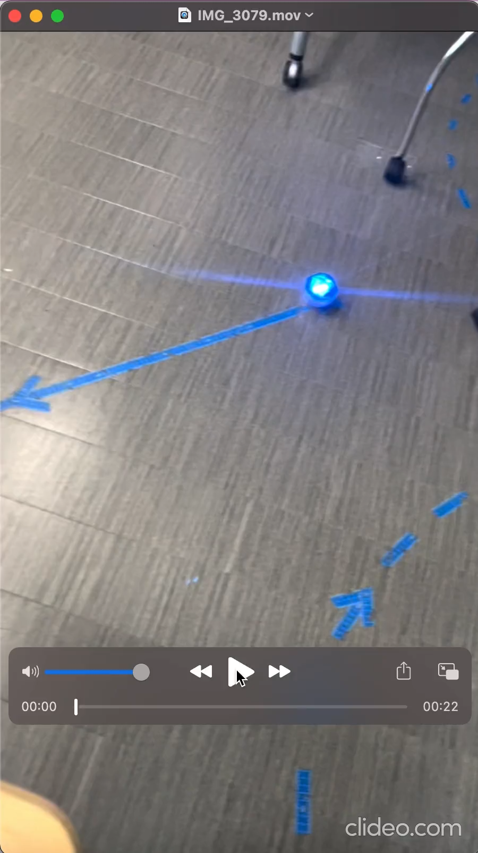
Sprint 3 Video
https://github.com/giannarao/Agility.git

Slide 4
Challenges Faced
Making the Sprint 2 code for the figure 8
It was difficult to make sure it stayed close to the path 5 times
Taking the videos of each sprint
The robot didn’t hold its charge for a long time
Writing the System Design Document for the first time

Slide 5
Roles of Team Members Main contributions:
Gianna:
Creating block code
Video
Gantt Chart
Chris:
Requirement Table
Test Table
Flowchart
Both:
System Design Document
Collab on Github

Slide 6
What Was Learned About Software Engineering
You have to document every step of the process in a System Design Document
You have to test the product multiple times to make sure it works correctly
Learned how to use Sphero
How to work as a group on a software engineering project
Software engineering is more than coding
Trial and Error

Slide 7
What Could Have Been Done Differently
Not much could’ve been done to make a drastic change to our project, most of our errors were minor and just calculating timing and speed.
Possibly work with others from a different group about our errors and how they were dealing with the problem.
Was hard to find times to meet but maybe we could’ve found something to help collaborate better.
Maybe have multiple robots and have different times and speeds and see which have better statistics.

